Slide 1
Neural ODEs for Physical Systems
Jagpreet Jakhar
Supervisor: Dr. Matthew Ellis
Department of Computer Science
University of Sheffield

Slide 2
Overview
Aims & objectives
Background
Methodology
Experiments
Results
Conclusions
Future Work

Slide 3
Aims & Objectives
Aim :Explore the potential of a particular ML approach known as Neural Ordinary Differential Equations (NODEs) for modeling specific physical systems that exhibit complex non-linear dynamics.
Objectives:
Training NODEs on Lorenz Model simulation.
Training NODEs on Double Pendulum simulation
Training NODEs for predicting Domain Wall dynamics of a copper nanowire.
Evaluating NODEs - advantages, disadvantages, and limitations

Slide 4
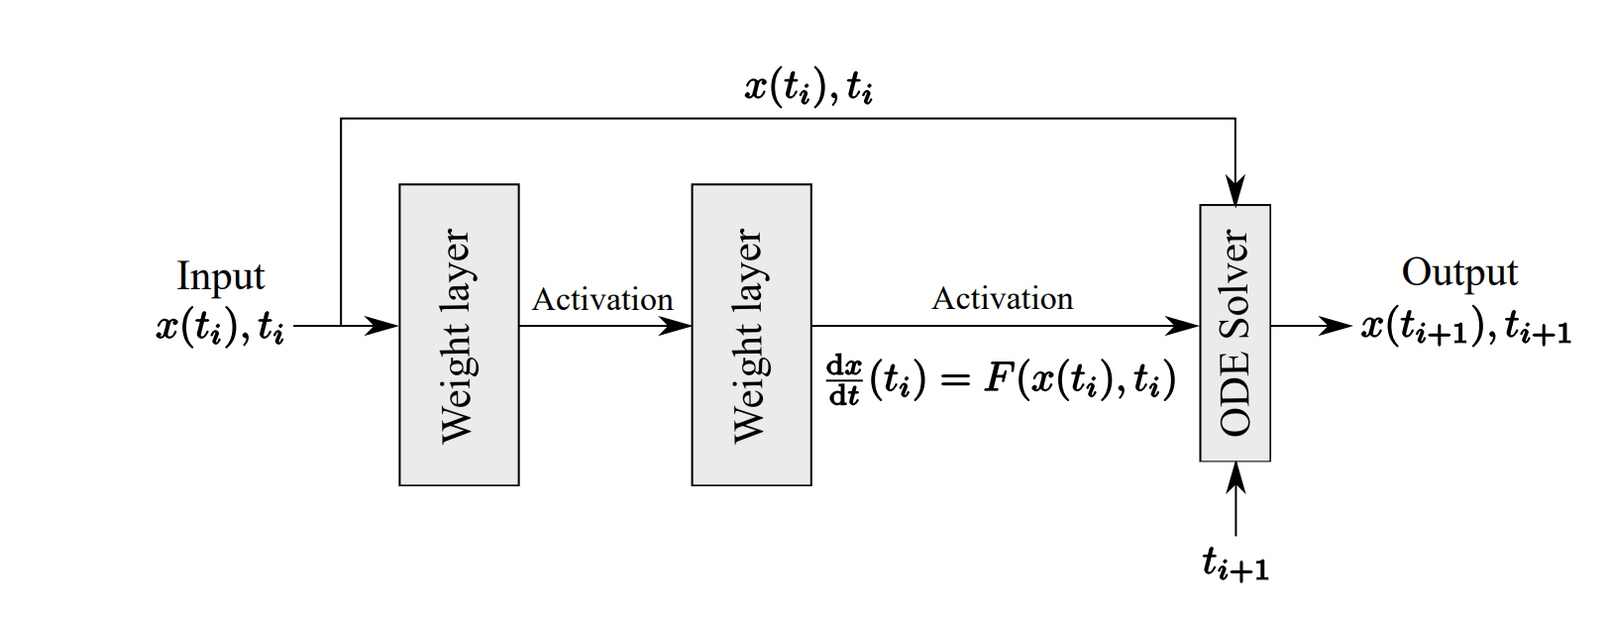
Background-1
We explore a data-driven approach to learn dynamical systems from data governed by ordinary differential equations using Neural Ordinary Differential Equations(NODEs), popularized by Ricky TQ chen in his paper.
Based on the notion that the skip connections in Residual Networks can be seen as a realization of Euler’s method for numerically solving ODEs. Instead of letting the network learn the residuals between fixed points as in ResNet, ODENet parameterises the local derivative of the input data with a neural network block.

Slide 5
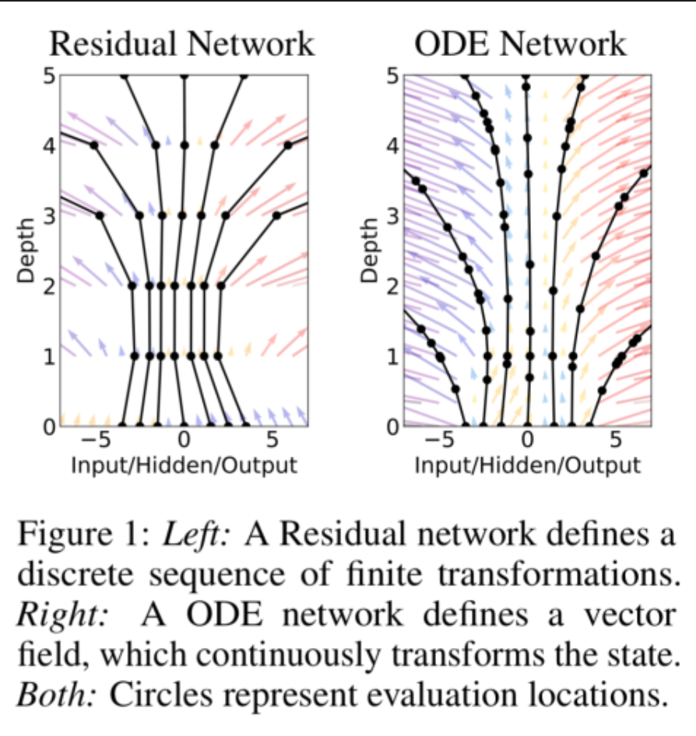
Background-2
They then let an ODE solver be responsible for the steps taken from an input xi at time ti to an output xi+1 at time ti+1, with the derivative at each point fed to the ODE solver to take each step.

Slide 6
Methodology
In all Problems, A Multilayer Perceptron is parametrised using the Neural ODE
Torchdiffeq, a ODE solver library for PyTorch was used as a blackbox ODE solver with support for Adjoint based backpropagation.
DIfferent batch_sizes and activation functions were used depending on the suitability to problem at hand, for example, ReLu for Lorenz problem, LeakyRelu for Double Pendulum Problem and a combination of LeakyReLu and tanh for domain wall problem.
Evaluation was done based on two metrics:
Forecasting ability
Generalization ability

Slide 7
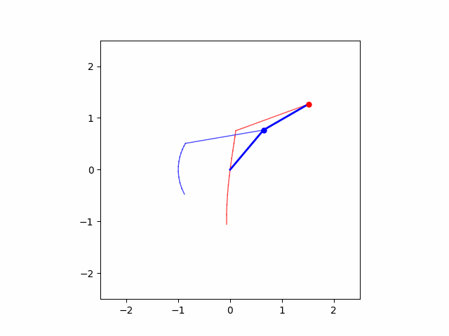
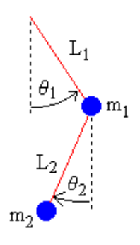
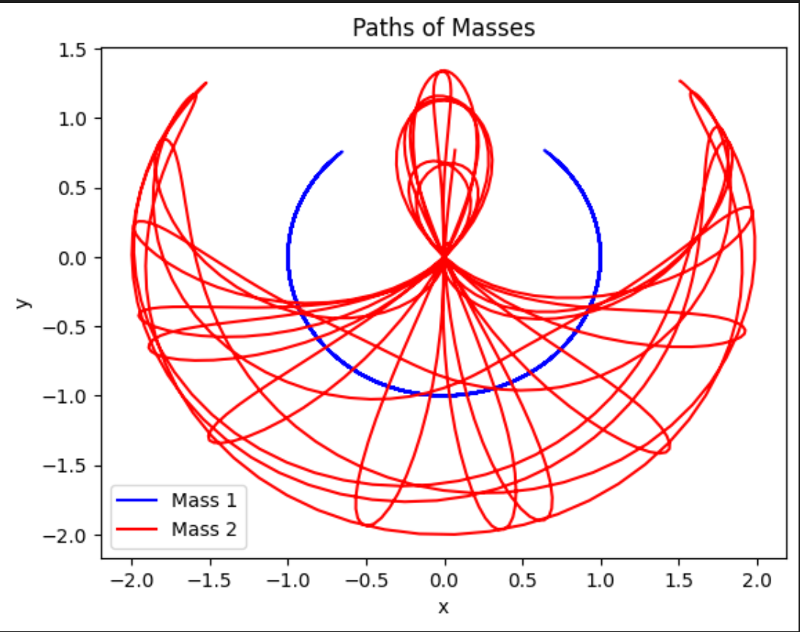
Double Pendulum
Involves two connected pendulums, where each pendulum consists of a mass attached to a rod that can swing freely.
Exhibits chaotic behavior and is highly sensitive to initial conditions.
NODE is trained to predict the angles Theta1 and Theta2.

Slide 8
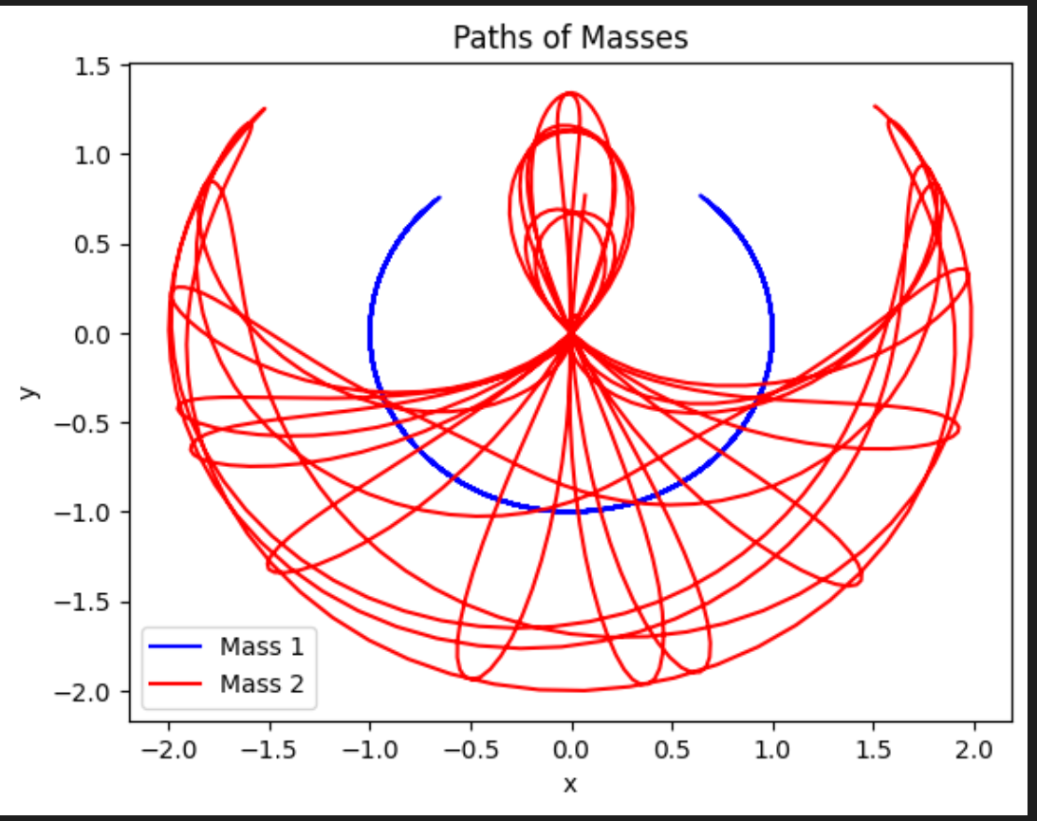
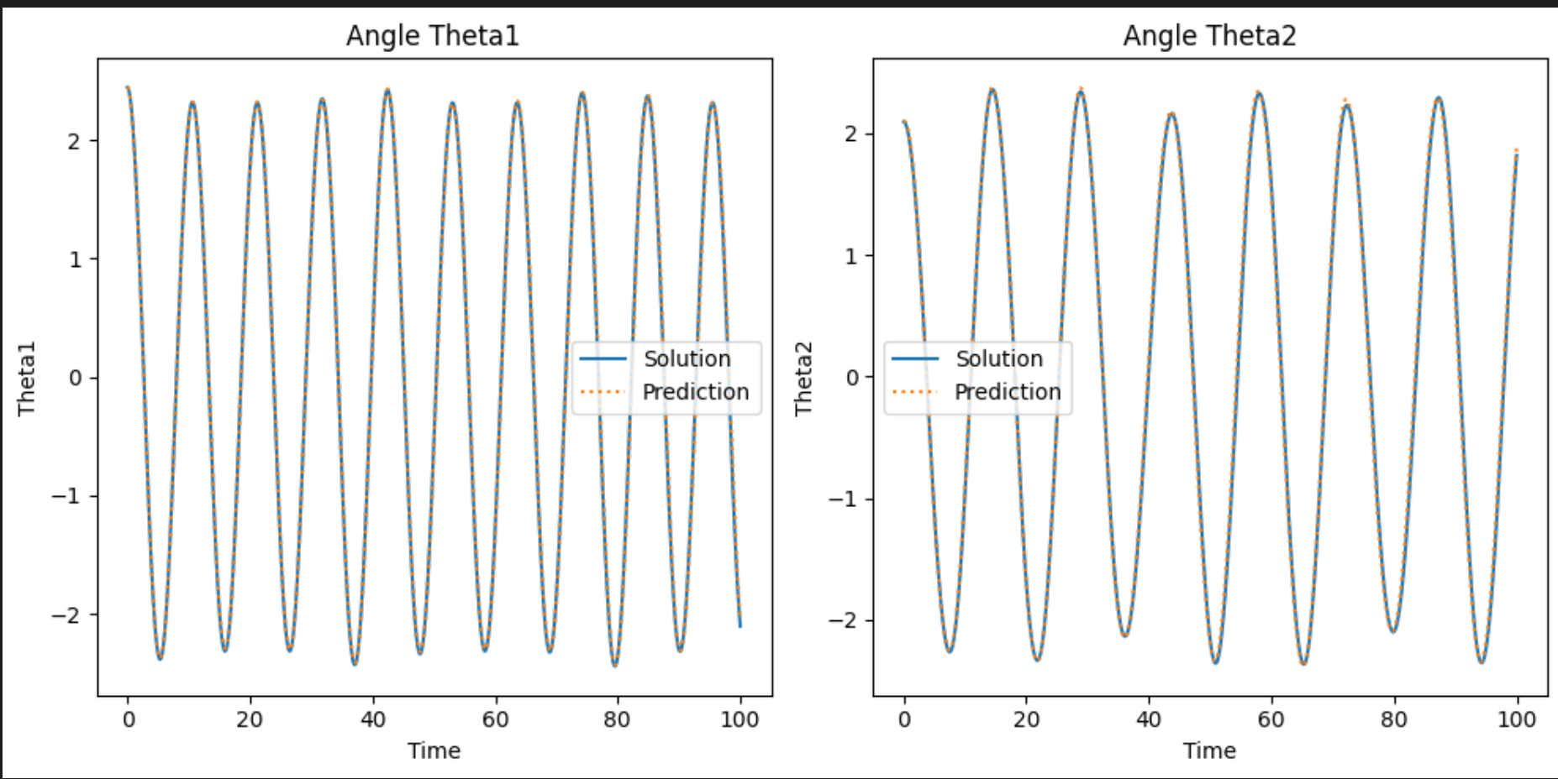
Double Pendulum Results:

Slide 9
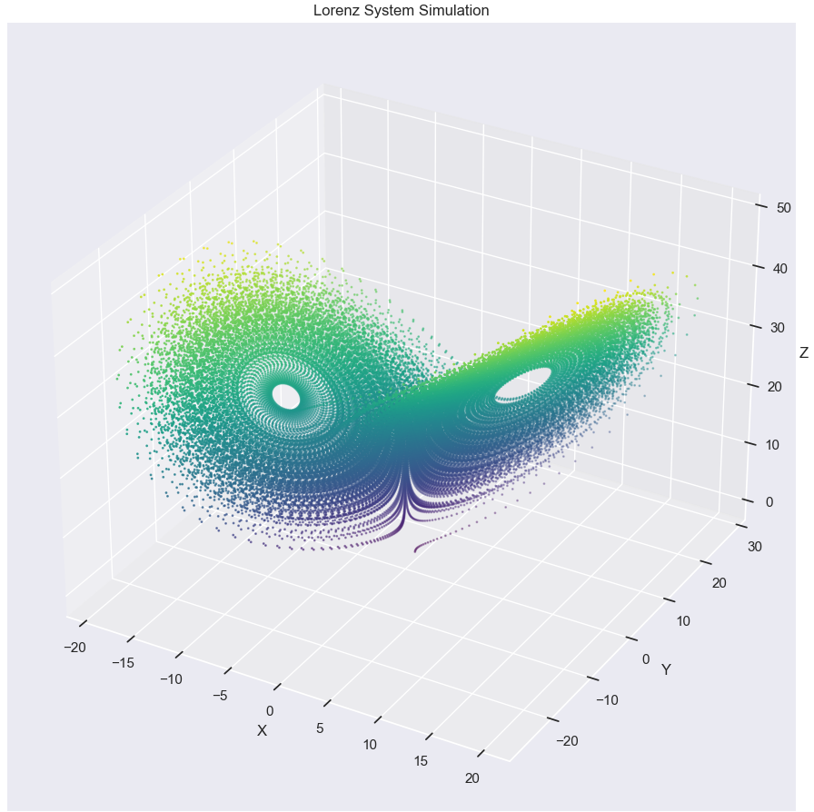
Lorenz Attractor
The Lorenz attractor is a well-known chaotic system that exhibits complex and unpredictable behavior. It was first studied by Edward Lorenz in 1963 and has since become a prominent example in the field of chaos theory.

Slide 10
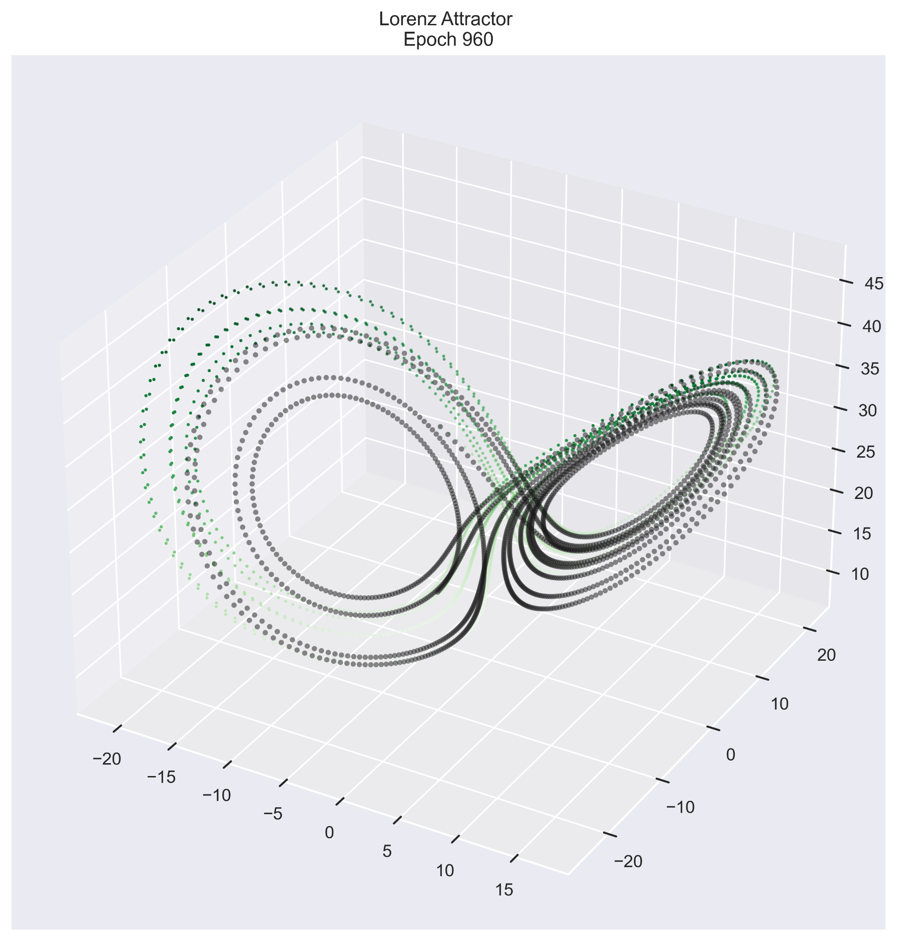
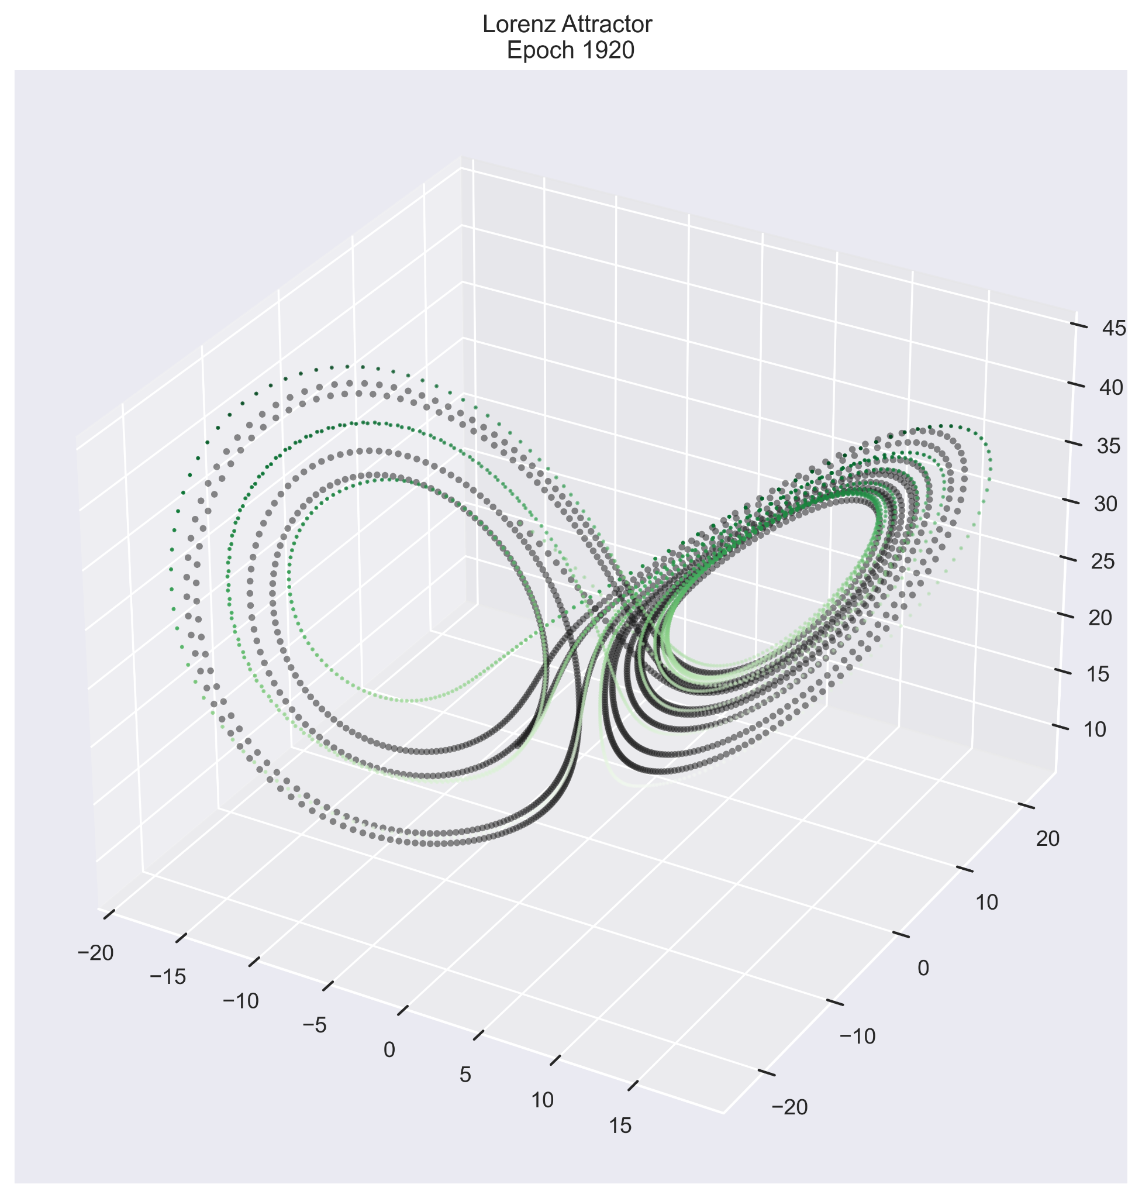
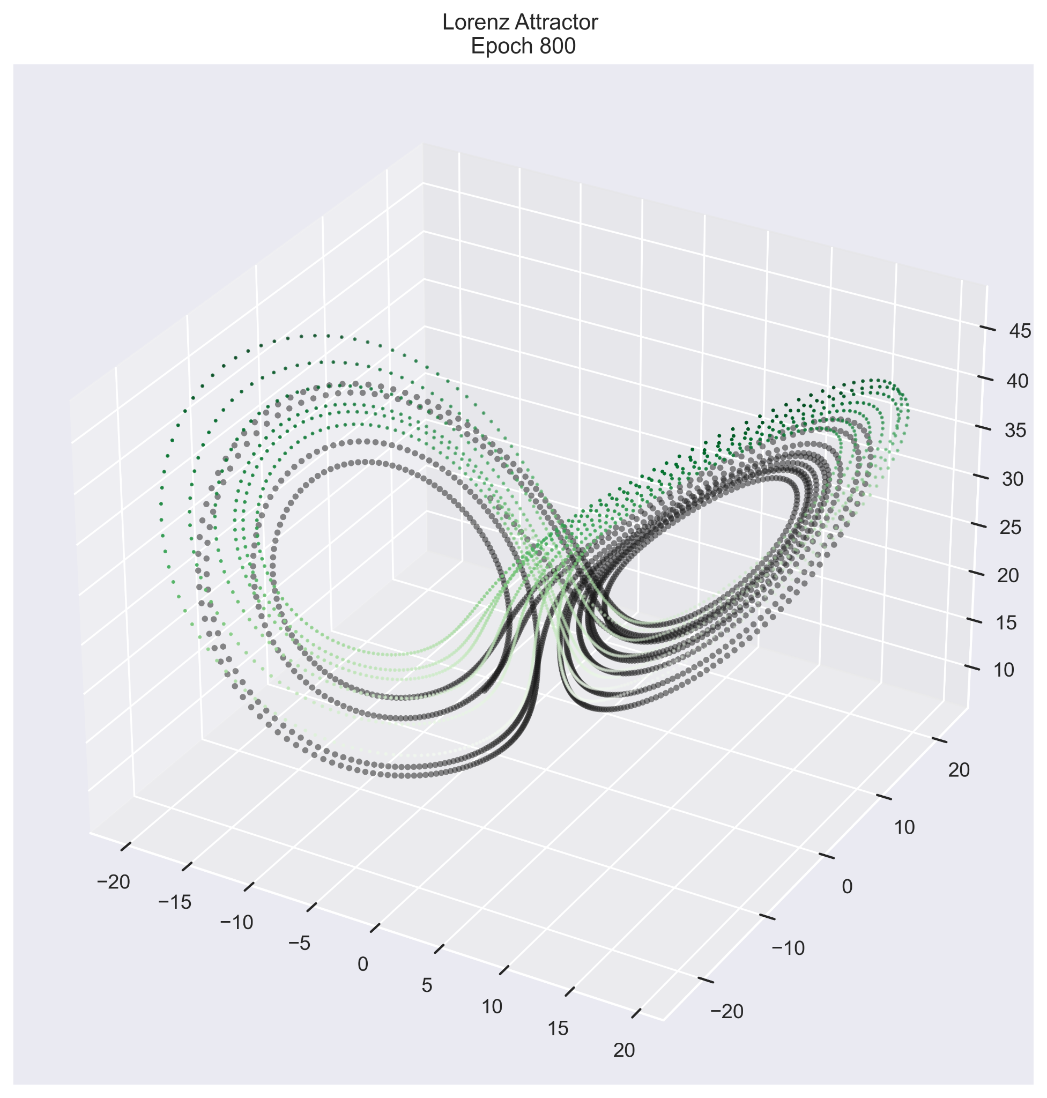
Lorenz Train

Slide 11
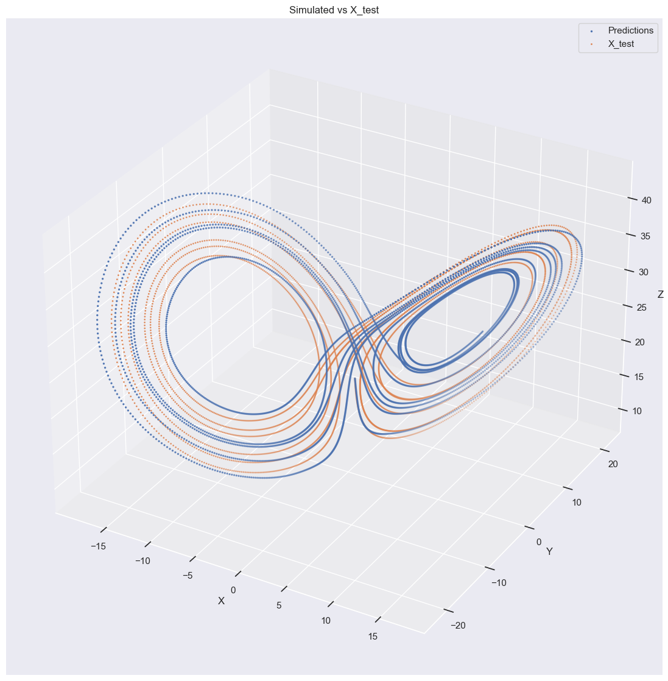
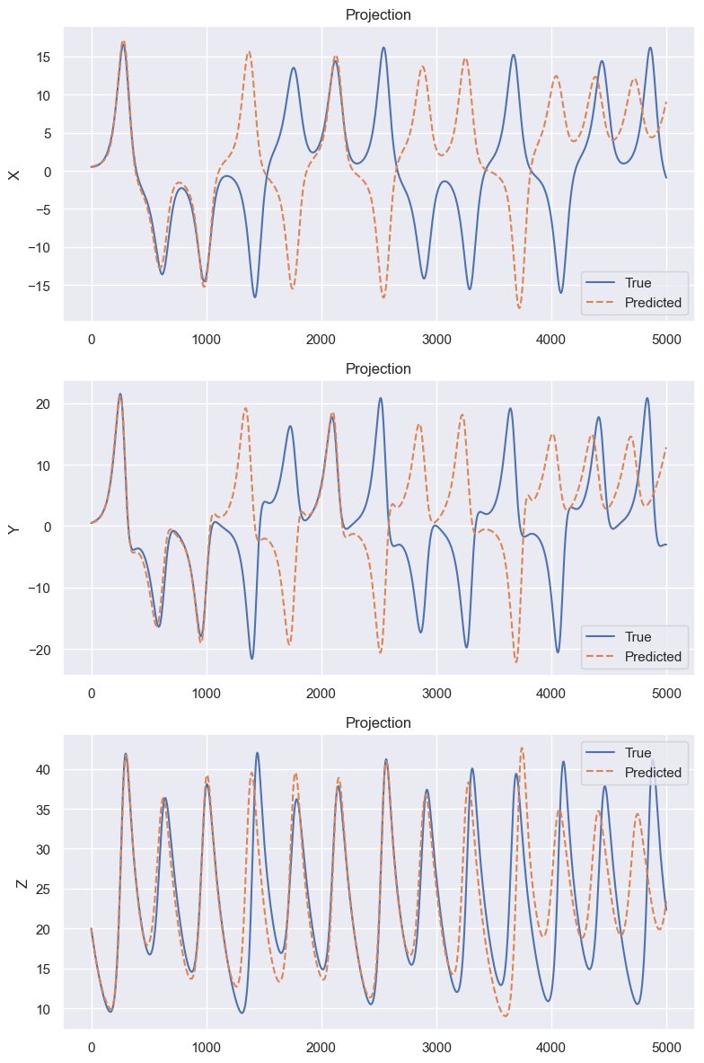
Lorenz Test

Slide 12
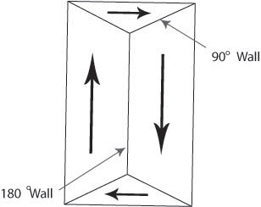
Domain Wall
Domain walls separate regions where the magnetic moments of atoms or ions are aligned in different directions.
A sinusoidal input is given explicitly and the Domain Wall Position and angles are predicted for two cases, namely : when a single field is applied, and when multiple fields are applied.
Domain Walls separating different fields.

Slide 13
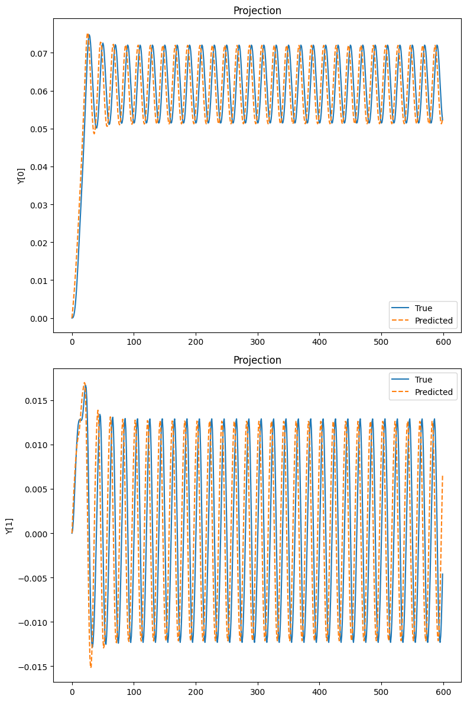
Domain Wall - Single Field
Position
Angle

Slide 14
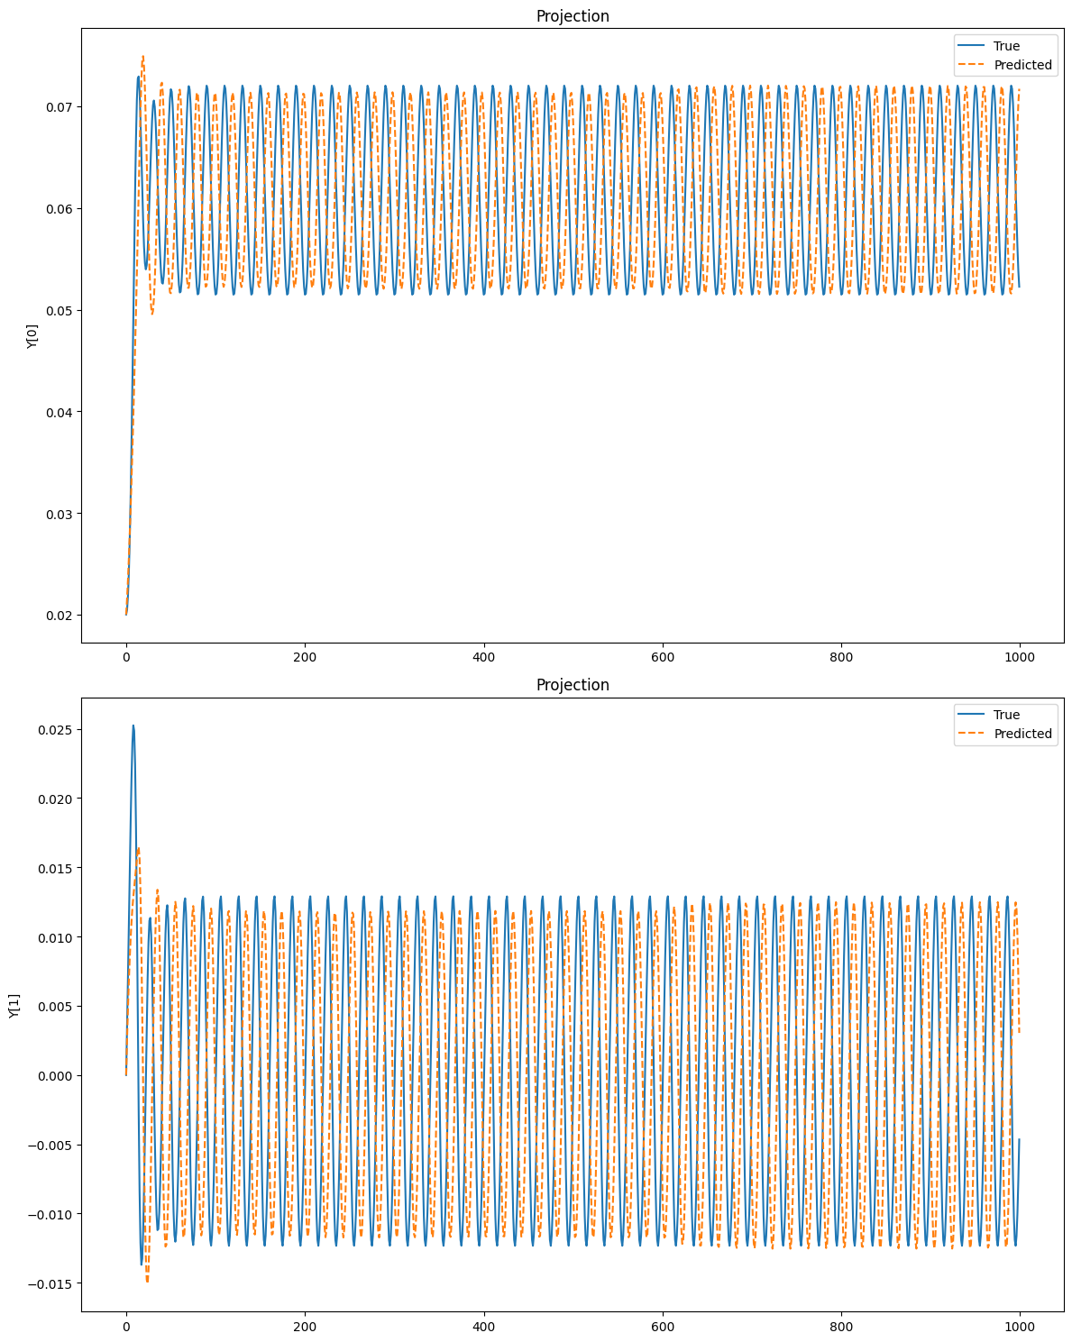
Domain Wall Single Field-Test Data
Tested on different initial condition

Slide 15
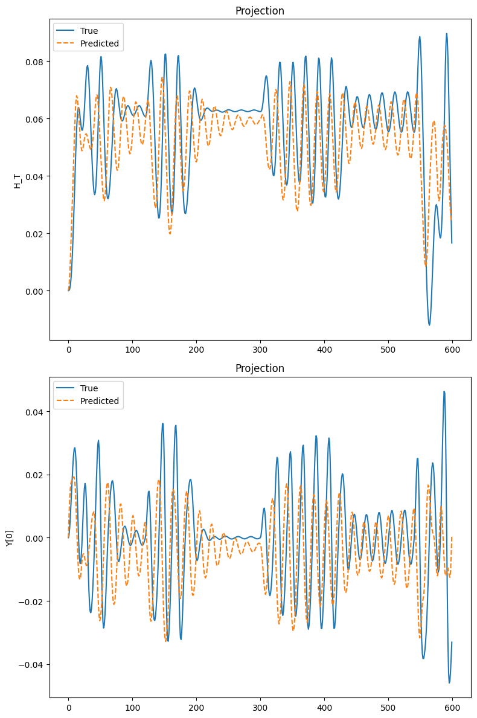
Domain Wall Multiple Fields

Slide 16
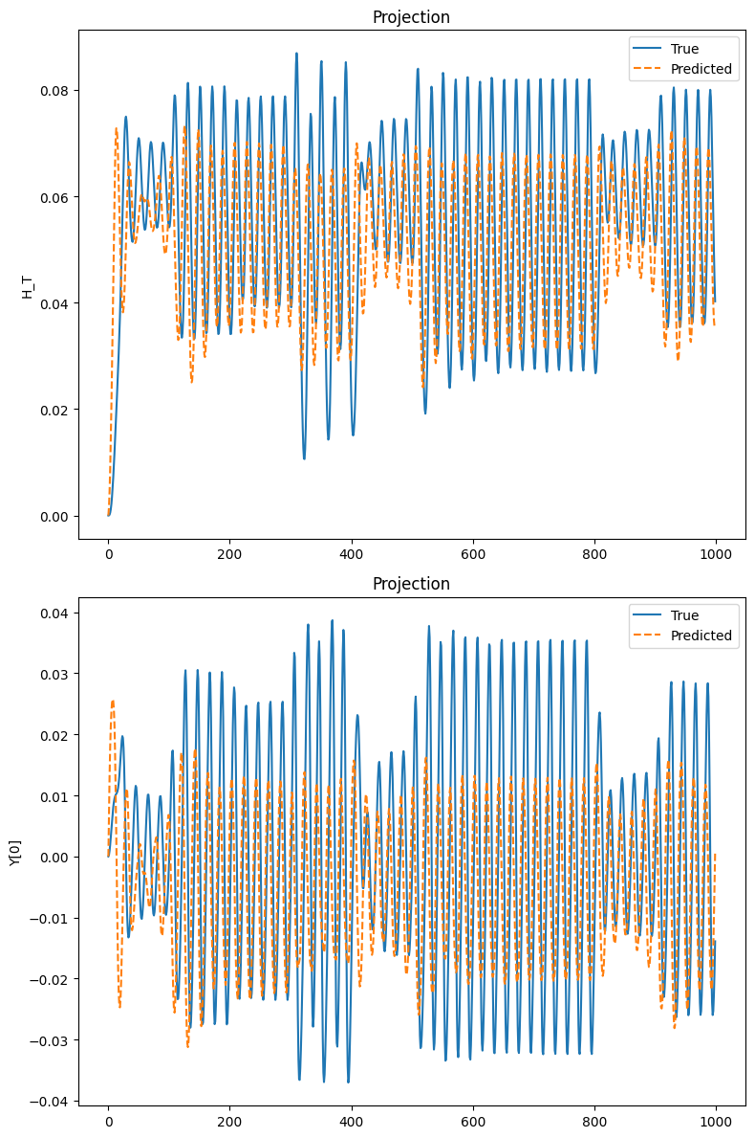
Domain Wall Multiple Fields Test

Slide 17
Results
NODE are found to perform well on the double pendulum problem performing well on both forecasting and Generalisation abilities.
On the Lorenz Attractor Problem, the model goes out of phase after some time steps, but is still an improvement over vanilla RNNs used for the same purpose.
For Domain Wall Problem, the model struggles in cases of abrupt phase shifts, and has limited generalizability both for single field as well as multiple fields cases.

Slide 18
Conclusions
Neural ODE Advantages :
Adjoint based backpropagation, O(1) memory cost w.r.t network depth.
Use of ODE Solvers - Error Management
Well established theory of Ordinary Differential Equations helps guide us build new architectures
Continuous in time
Wide applicability - Fluid Mechanics to stock markets.
Neural ODE Limitations:
ODEs can be slow to solve, especially Stiff ODE cases
Whole trajectory must be solved
Limited representation as Trajectories can’t cross, so limited to homeomorphisms.{the continuous evolution of the ODE ensures that any topological property of its input must be preserved.}

Slide 19
Future Work
Augmented Neural ODEs (ANODEs)
Second Order Neural ODEs(SONODEs)
Hamiltonian Neural Networks
Lagrangian Neural Networks

Slide 20
Any questions?

